Slide 1
CIFAR100 Image Classification
Milestone 3
CMPE 257 Group 6

Slide 2
Group Members
Xiyu Cao Meng Wang
Yuxue Jiang Mengguo Yan
Qianhui Lu Yihui Zhou
Notes:
Dictionary created to store

Slide 3
Presentation Outline
Problem Statement
ML algorithm Design with architecture diagram
Feature Engineering with:
Grid search
Feature Extraction
Data Augmentation
Performance Summary table
Model Evolution for milestone 1, 2, 3
Lesson learned
What to improve in the future
References
Notes:
Dictionary created to store

Slide 4
Problem Statement

Slide 5
Problem Statement
The purpose of this project is to separate large man-made outdoor things [bridge, castle, house, road, skyscraper] from large natural outdoor scenes [cloud, forest, mountain, plain, sea] using Cifar 100 dataset
Prediction on randomly selected testing images
Prediction on one testing subclass image from each of superclass
Prediction on two testing subclass images from each of superclass
Different machine learning models will be used and then different feature extractions will be used in training and testing.

Slide 6

Algorithms
Logistic Regression
SVM
Random Forest
Extra Tree
Gradient Boosting
DenseNet

Slide 7
Data Augmentation &
Feature Engineering

Slide 8
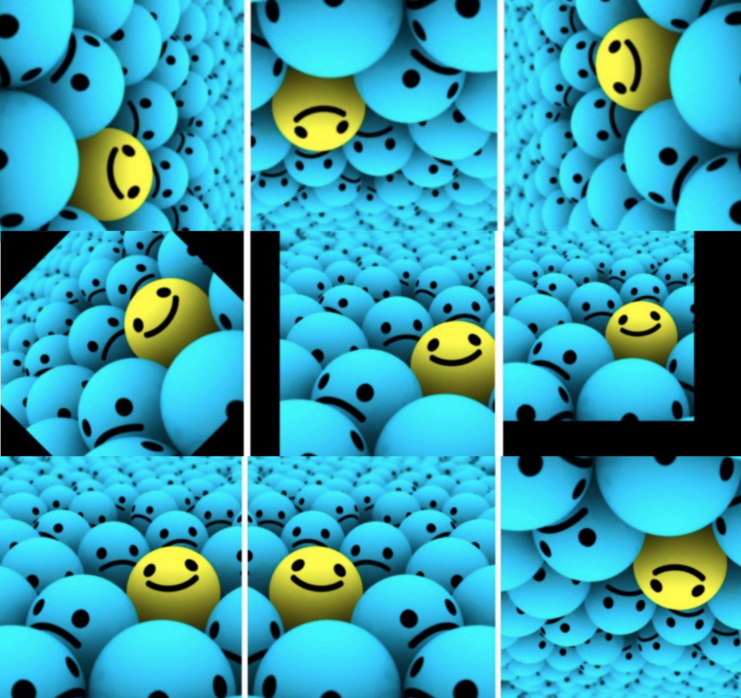

Data Augmentation
Data shape: 3600*32*32*3
Data shape: 13200*32*32*3

Slide 9
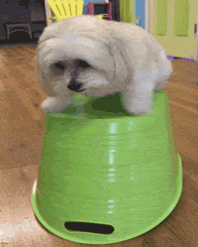
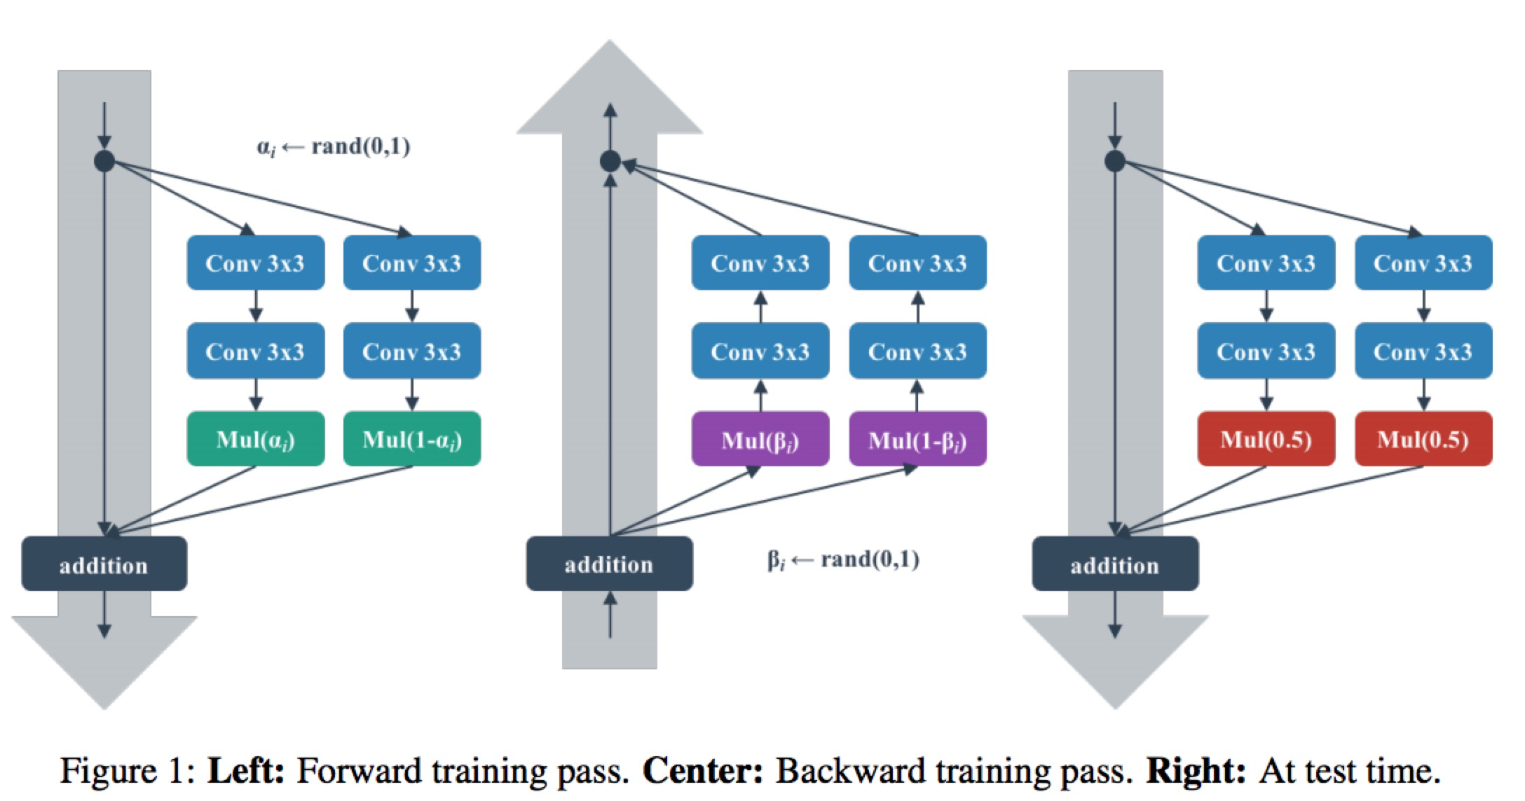
Data Augmentation
ShakeShake*
keras.preprocessing.image.ImageDataGenerator()
featurewise_center
Samplewise_center
Featurewise_std_normalization
Samplewise_std_normalization
Zca_epsilon
Zca_whitening
Rotation_range
Width_shift_range
Height_shift_range
Brightness_range
Shear_range
zoom_range
3-branch ResNets to produce the effect by stochastically "blending" 2 viable tensors after data augmentation.
*"Shake" means that all scaling coefficients are overwritten with new random numbers before the pass.
Notes:
The row vector (3072) has the exact same number of elements if you calculate 32*32*3==3072. In order to reshape the row vector, (3072), there are two steps required. The first step is involved with using reshape function in numpy, and the second step is involved with using transpose function in numpy as well.
Reshape function gives a new shape to an array without changing its data. Here, the phrase without changing its data is an important part. reshape operations should be delivered in three more detailed step. The following direction is described in a logical concept.
divide the row vector (3072) into 3 pieces. Each piece corresponds to the each channels.
this results in (3 x 1024) dimension of tensor
divide the resulting tensor from the previous step with 32. 32 here means width of an image.
this results in (3 x 32 x 32)
In order to implement the directions written in logical sense in numpy, reshape function should be called in the following arguments, (10000, 3, 32, 32). As you noticed, reshape function doesn't automatically divide further when the third value (32, width) is provided. We need to explicitly specify the value for the last value (32, height)
This is not the end of story. Now, the image data is represented as (num_channel, width, height) form. However, this is not the shape tensorflow and matplotlib are expecting. They are expecting different shape of (width, height, num_channel) instead. We need to swap the order of each axes, and that is where transpose function comes in.
The transpose function can take a list of axes, and each value specifies where it wants to move around. For example, calling transpose with argument (1, 2, 0) in an numpy array of (num_channel, width, height) will return a new numpy array of (width, height, num_channel).

Slide 10

Feature Extraction
Different Colors Ratios
Saturation Average
Image Gradient (OpenCV function)
Image Histogram (OpenCV function)
Gray Scale (OpenCV function)
Data shape: 13200*4098
Data shape: 13200*32*32*3
90% PCA - Final Data shape: 13200*127
Notes:
The row vector (3072) has the exact same number of elements if you calculate 32*32*3==3072. In order to reshape the row vector, (3072), there are two steps required. The first step is involved with using reshape function in numpy, and the second step is involved with using transpose function in numpy as well.
Reshape function gives a new shape to an array without changing its data. Here, the phrase without changing its data is an important part. reshape operations should be delivered in three more detailed step. The following direction is described in a logical concept.
divide the row vector (3072) into 3 pieces. Each piece corresponds to the each channels.
this results in (3 x 1024) dimension of tensor
divide the resulting tensor from the previous step with 32. 32 here means width of an image.
this results in (3 x 32 x 32)
In order to implement the directions written in logical sense in numpy, reshape function should be called in the following arguments, (10000, 3, 32, 32). As you noticed, reshape function doesn't automatically divide further when the third value (32, width) is provided. We need to explicitly specify the value for the last value (32, height)
This is not the end of story. Now, the image data is represented as (num_channel, width, height) form. However, this is not the shape tensorflow and matplotlib are expecting. They are expecting different shape of (width, height, num_channel) instead. We need to swap the order of each axes, and that is where transpose function comes in.
The transpose function can take a list of axes, and each value specifies where it wants to move around. For example, calling transpose with argument (1, 2, 0) in an numpy array of (num_channel, width, height) will return a new numpy array of (width, height, num_channel).

Slide 11
Milestone 3 Models Comparison

Slide 12
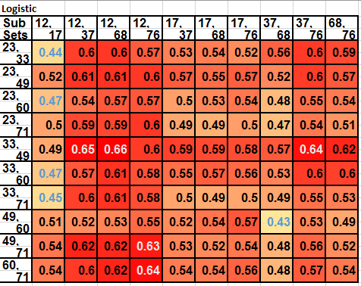
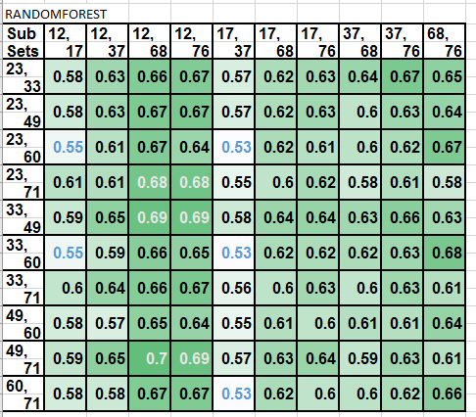
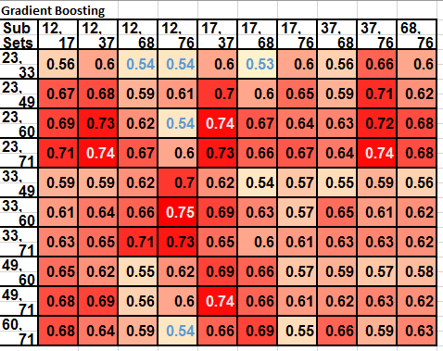
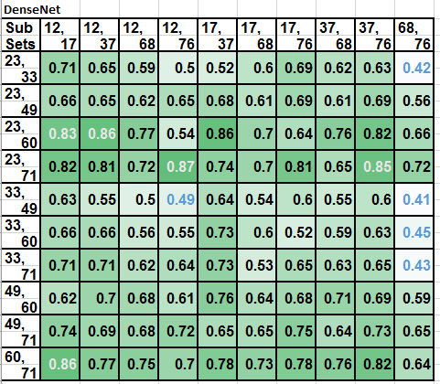
Index Code
[12, 'bridge']
[17, 'castle']
[23, 'cloud']
[33, 'forest']
[37, 'house']
[49, 'mountain']
[60, 'plain']
[68, 'road']
[71, 'sea']
[76, 'skyscraper']

Slide 13
Milestone 3 Model Summary (10x10)
 | Logistic Regression | Random Forest | Gradient Boosting | DenseNet
Average | 0.55 | 0.62 | 0.63 | 0.66
Std | 0.049 | 0.039 | 0.055 | 0.1
25% | 0.52 | 0.6 | 0.59 | 0.61
50% | 0.55 | 0.61 | 0.63 | 0.66
75% | 0.59 | 0.65 | 0.67 | 0.73
Best Result | 0.66 (bridge,road) (forest,mountain) | 0.70 (bridge,road), (mountain,sea) | 0.75 (bridge,skyscraper) (forest,plain) | 0.86 (bridge,house) (cloud,plain)
Worst Result | 0.44 (bridge,castle) (forest,sea) | 0.56 (bridge, castle) (forest,plain) | 0.53 (castle,road) (forest,cloud) | 0.41 (road,skyscraper) (forest,mountain)

Slide 14
Performance Improvement

Slide 15
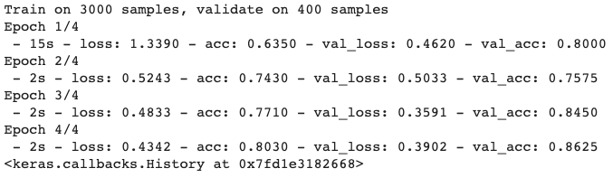
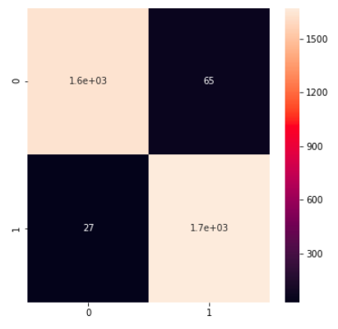
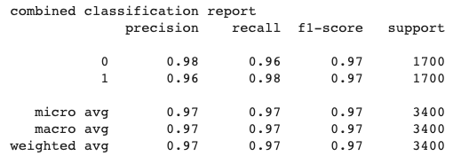
DenseNet - results on the least challenging categories:
Bridge, Skyscraper, Cloud, Sea (applied on 150 epochs)
Best Validation Accuracy: 0.86
Test/Validation Score
Confusion Matrix
Classification Report

Slide 16
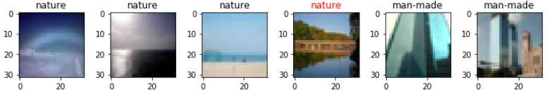
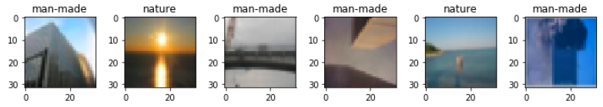
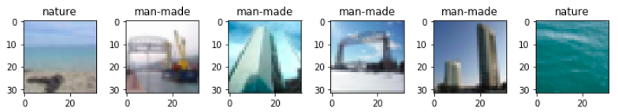
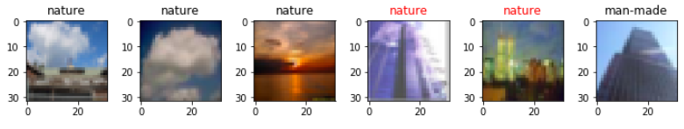

Slide 17
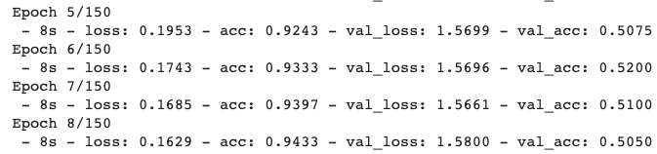
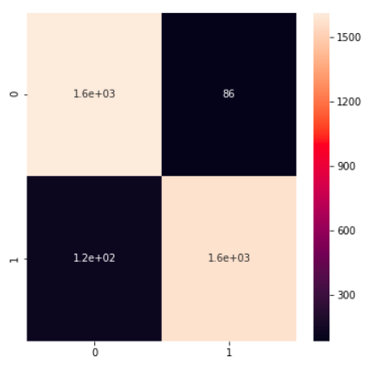
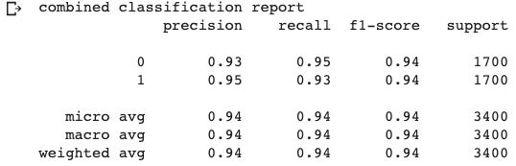
DenseNet - results on the most challenging categories:
Road, Skyscraper, forest, mountain (applied on 150 epochs)
Best Validation Accuracy: 0.52
Test and Validation Score
Confusion Matrix
Classification Report

Slide 18
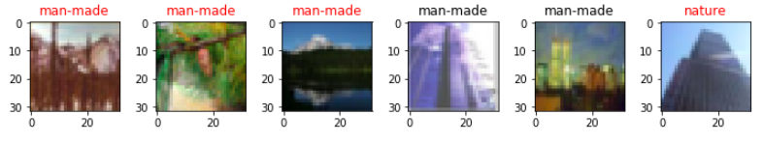
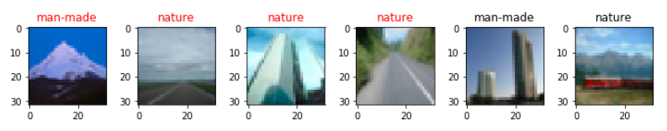
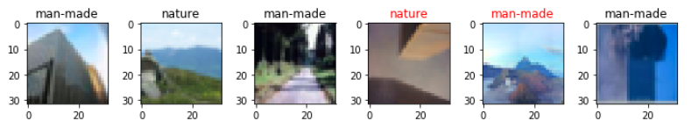
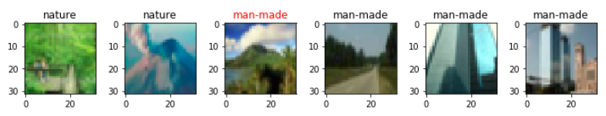

Slide 19
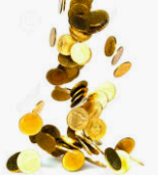
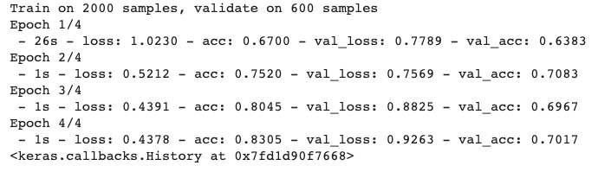
$$ Bonus Point $$
What if we use 3 subclasses as test data?
Best Validation Accuracy Score: 0.70

Slide 20
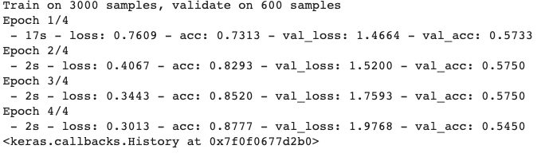
$$ Bonus Point $$
What if we use 3 subclasses as test data?
Worst Validation Accuracy Score: 0.57

Slide 21
DenseNet Performance evolvement
Milestone 1
Milestone 2
Milestone 3
Bonus Point
Train/Test data:
All
Test data:
Take out 1 subclass
Test data:
Take out 2 subclasses
each
Test data:
Take out 3 subclasses each
Validation Accuracy Score:
Max | 0.905 | 0.88 | 0.865 | 0.70
Min | 0.65 | 0.53 | 0.52 | 0.57
Mean | 0.82 | 0.76 | 0.67 | 0.62

Slide 22
DenseNet 101
Pros:
1. by adding layers in deep neural network, the number of parameters to learn could be reduced.
2. CNN increases learning efficiency and separates information to pass on in different layers.
Cons:
1. needs computational power, Graphic Processing Unit.
2. takes time to train, for example, in our work we need to run 100 pairs, even though each pair reduced to run only 3 epochs, it takes 10 hours in total on Colab.

Slide 23
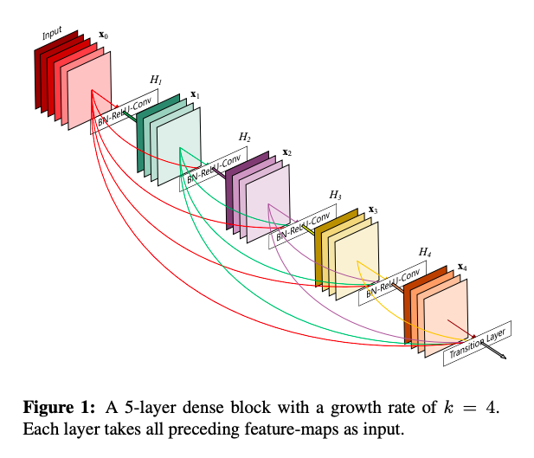
DenseNet 101

Slide 24
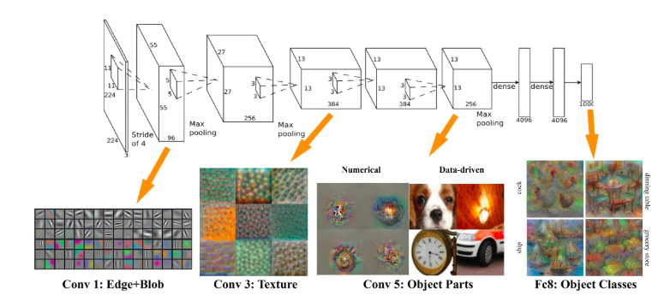
DenseNet 101

Slide 25
Model Summary

Slide 26
Milestone 2 Model Summary (5x5)
 | Logistic Regression | Random Forest | Gradient Boosting | DenseNet
Average | 0.55 | 0.5 | 0.67 | 0.76
Std | 0.116 | 0.086 | 0.118 | 0.1
25% | 0.465 | 0.51 | 0.59 | 0.66
50% | 0.55 | 0.59 | 0.67 | 0.73
75% | 0.6225 | 0.65 | 0.77 | 0.81
Best Result | 0.75 (skyscraper, cloud) | 0.70 (skyscraper, cloud) | 0.87 (house, sea) | 0.88 (house, plain)
Worst Result | 0.33 (house, forest) | 0.41 (road, forest) | 0.43 (road, forest) | 0.53 (road,forest)

Slide 27
Milestone 3 Model Summary (10x10)
 | Logistic Regression | Random Forest | Gradient Boosting | DenseNet
Average | 0.55 | 0.62 | 0.63 | 0.66
Std | 0.049 | 0.039 | 0.055 | 0.1
25% | 0.52 | 0.6 | 0.59 | 0.61
50% | 0.55 | 0.61 | 0.63 | 0.66
75% | 0.59 | 0.65 | 0.67 | 0.73
Best Result | 0.66 (bridge,road) (forest,mountain) | 0.70 (bridge,road), (mountain,sea) | 0.75 (bridge,skyscraper) (forest,plain) | 0.86 (bridge,house) (cloud,plain)
Worst Result | 0.44 (bridge,castle) (forest,sea) | 0.56 (bridge, castle) (forest,plain) | 0.53 (castle,road) (forest,cloud) | 0.41 (road,skyscraper) (forest,mountain)

Slide 28
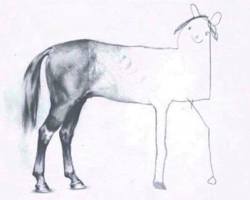
Model Evolution - Traditional Machine Learning
Feature Extraction
Grid Search
Feature Extraction
Data Augmentation
Milestone 1
Milestone 2
Milestone 3
We,
at Milestone 1
We,
at Milestone 2
Hopefully, we at Milestone 3

Slide 29
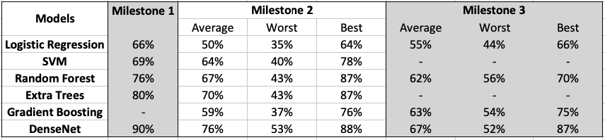
Model Evolution - Traditional Machine Learning

Slide 30
Lesson Learned

Slide 31

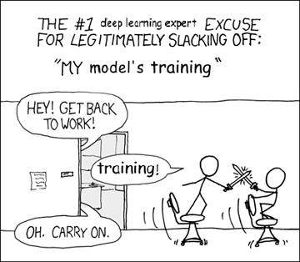
Lessons learned
Know data better: data is everything
Different feature extraction works for different image classes
Standing on the shoulders of giants
Transfer learning -- DenseNet
Paper/Github reading (Benchmarks.ai) and try different models out (shake-shake, ResNet …)
Know models better
Deep learning-- how to tune hyperparameters/why they work
Tradeoff -- no free lunch (accuracy vs time)
Coding, coding and coding skills
Data manipulation
Techniques for real-life size data: nohup, tmux, vim, etc...
Teamwork

Slide 32
Future Work

Slide 33
Future work
ResNet vs DenseNet
Figure out WHY

Slide 34
One more thing
If you are interested in applying our algorithm in your datasets, we are happy to share our codes with you.

Slide 35
Reference
Park, C. (2018), Image Classification with Cifar 10 Dataset, Retrieved from https://github.com/deep-diver/CIFAR10-img-classification-tensorflow/blob/master/CIFAR10_image_classification.ipynb
Keras Documentation, DenseNet, Retrieved from https://keras.io/applications/#densenet
Huang, G. (2018), Densely Connected Convolutional Networks, Retrieved from https://arxiv.org/pdf/1608.06993.pdf
Bharath, R. (2018), Data Augmentation, Retrieved from https://medium.com/nanonets/how-to-use-deep-learning-when-you-have-limited-data-part-2-data-augmentation-c26971dc8ced
Garbarino, M. (2008). Automatic classification of natural and synthetic images. Skolan för datavetenskap och kommunikation, Kungliga Tekniska högskolan.
Simen, T. (2019). Fooling Automated Surveillance Cameras: Adversarial Patches to Attack Person Detection, Retrieved from https://arxiv.org/abs/1904.08653
Gastaldi, X. (2017). Shake-Shake Regularization of 3-Branch Residual Networks. Workshop Track - ICLR 2017. https://pdfs.semanticscholar.org/22aa/426aeffb77339646cc03da8e94de22396efc.pdf

